Slide 1
Transactions p2pkh

Slide 2
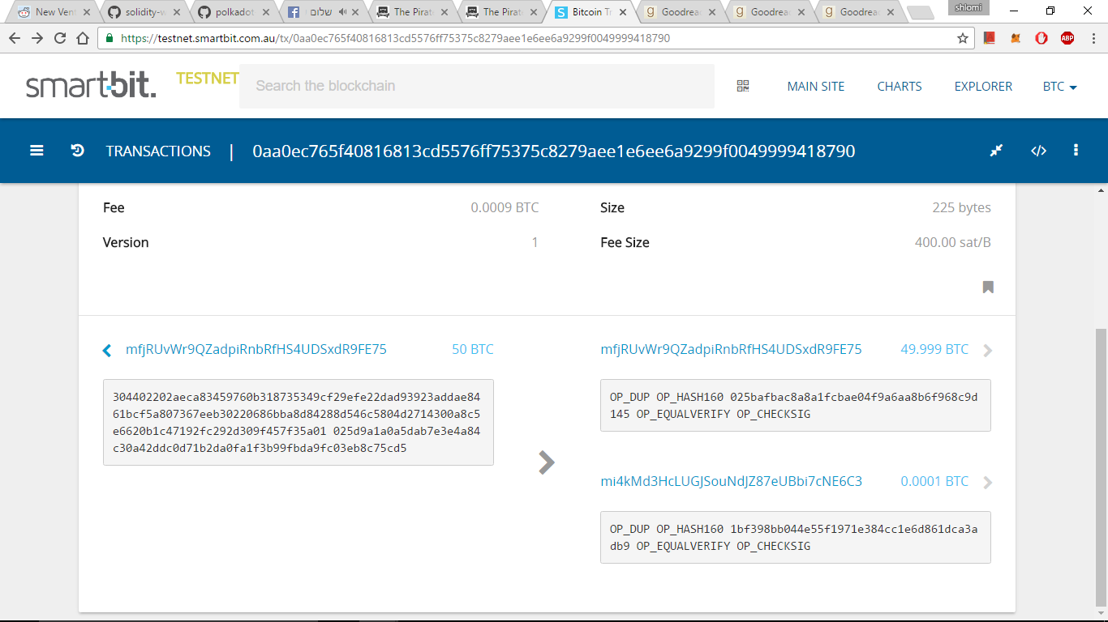
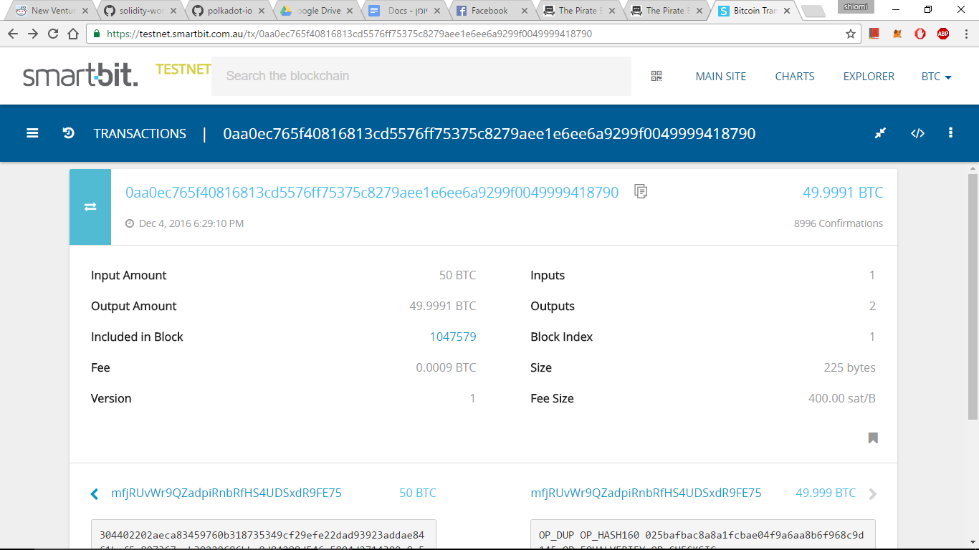
Transaction message
Inputs
 |  | Input 1
 |  |  | txId |  | …62865686ded400f8d73c1877f18a…
 |  |  | ScriptSig |  | For raw tx: previous output | For signed tx: signed message
Outputs
 | Output 1
 |  |  | Amount: |  | 5000
 |  |  | Script: |  | 76 a9 14 hashed_public_key_1 88 ac
 | Output 2
 |  |  | Amount: |  | 7000
 |  |  | Script: |  | 76 a9 14 hashed_public_key_2 88 ac
nLockTime

Slide 3
Stack and scripts

Slide 4

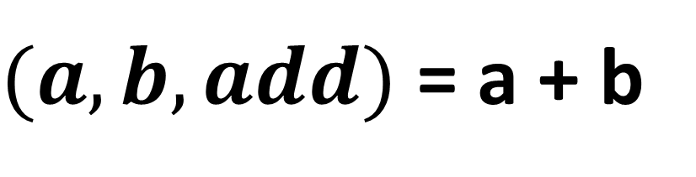
Polish notation
Basic operators:
Push (add item to the top of the stack)
Pop (remove item from the top of the stack)
$(a, b, add)$ = a + b
<Push> <2> <Push> <3> <Add>
5
3
2

Slide 5
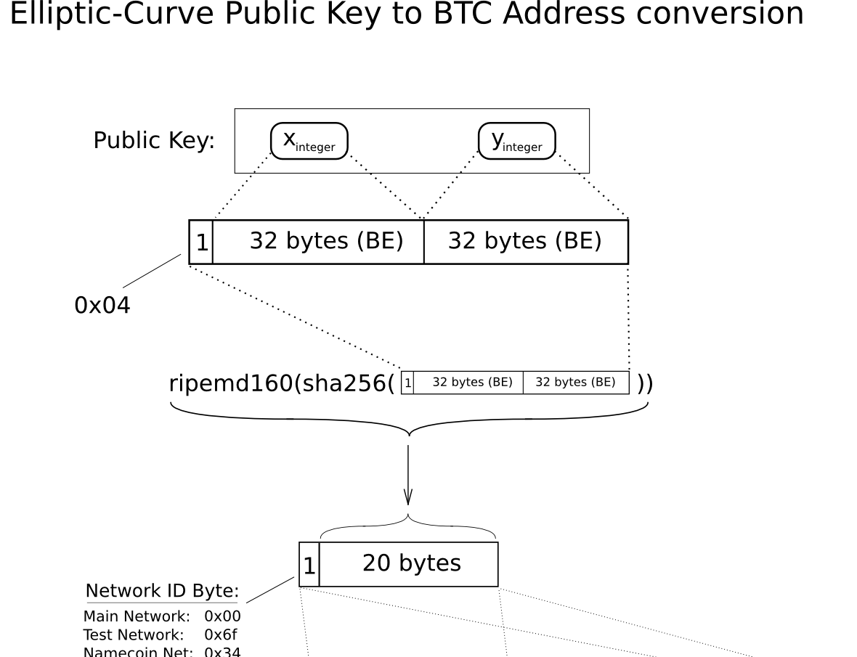
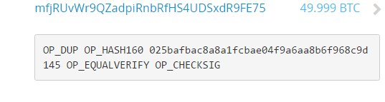
Pay to public key hash (p2pkh)
<76> <a9> <14> <hashed_public_key> <88> <ac>
<OP_DUP> <OP_HASH160> <OP_PUSH> <hashed_public_key> <OP_EQUALVERIFY> <OP_CHECKSIG>

Slide 6
Bob -> Charlie
<OP_DUP> <OP_HASH160> <OP_PUSH> <hashed_public_key> <OP_EQUALVERIFY> <OP_CHECKSIG>
Specified in the output section of the Alice->Bob transaction
The remote machine will hash the transaction and will assess the signature and public key that Bob provided.
If both equal, return 1
hashedPubKey
Specified by Alice
1
PubKey
hashedPubKey
Hashed
Duplicated
PubKey
Provided by Bob
Signature

Slide 7
Transaction message
Inputs
 |  | Input 1
 |  |  | txId |  | …62865686ded400f8d73c1877f18a…
 |  |  | ScriptSig |  | For signed tx: signed message
Outputs
 | Output 1
 |  |  | Amount: |  | 5000
 |  |  | Script: |  | 76 a9 14 hashed_public_key_1 88 ac
 | Output 2
 |  |  | Amount: |  | 7000
 |  |  | Script: |  | 76 a9 14 hashed_public_key_2 88 ac
nLockTime
The transaction Id (TXID) is the hash of the signed transaction

